Slide 1
Level of Detail (LOD) Management in Open-World Scenes
Efe Göçmen - 2022719225

Slide 2
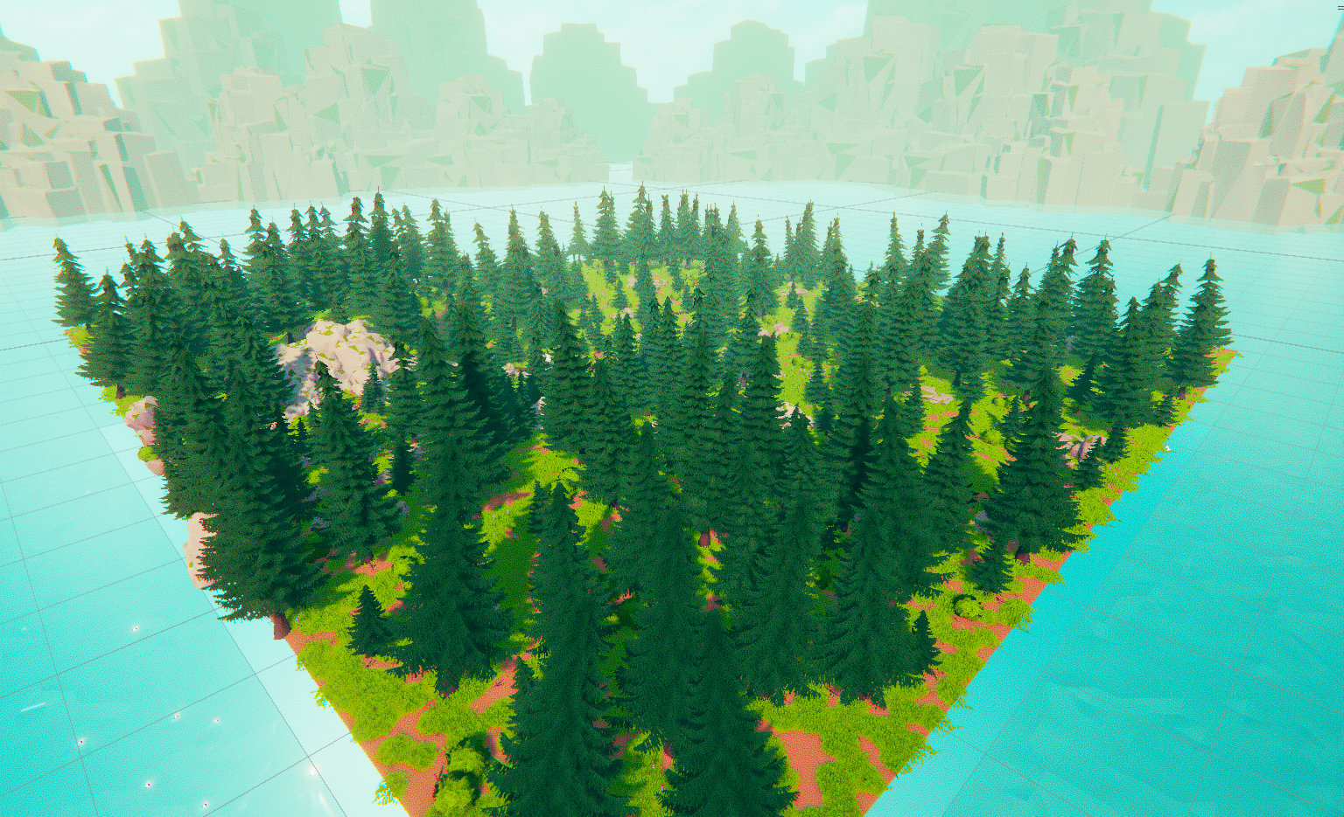

Slide 3
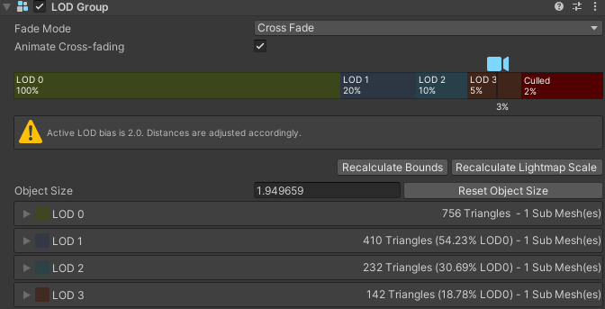

Slide 4
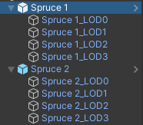
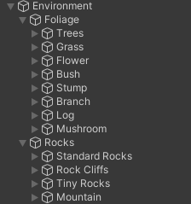
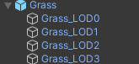

Slide 5
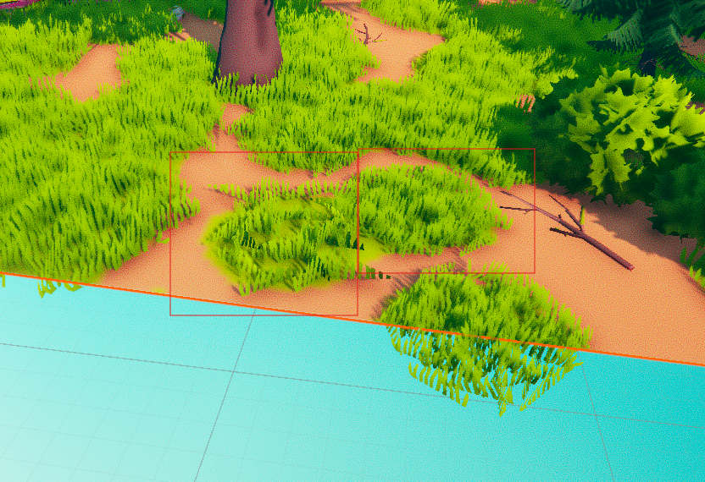

Slide 6
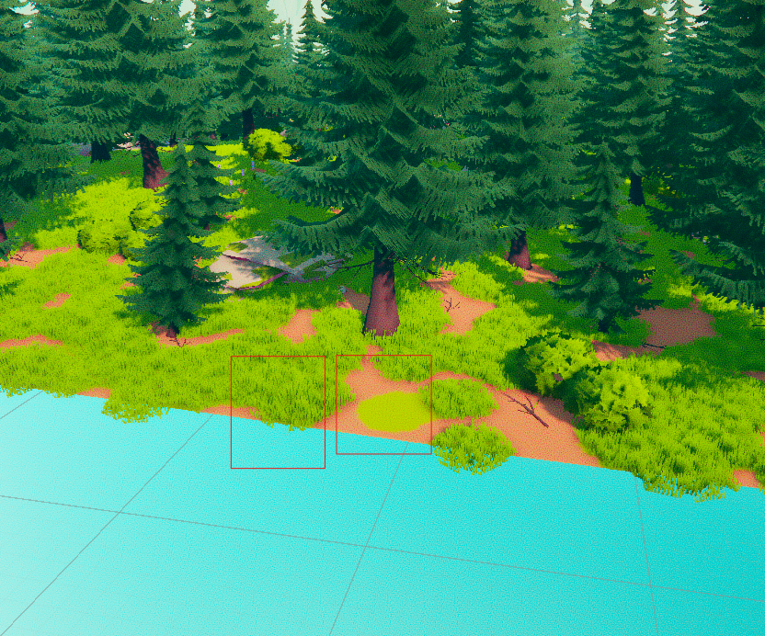

Slide 7
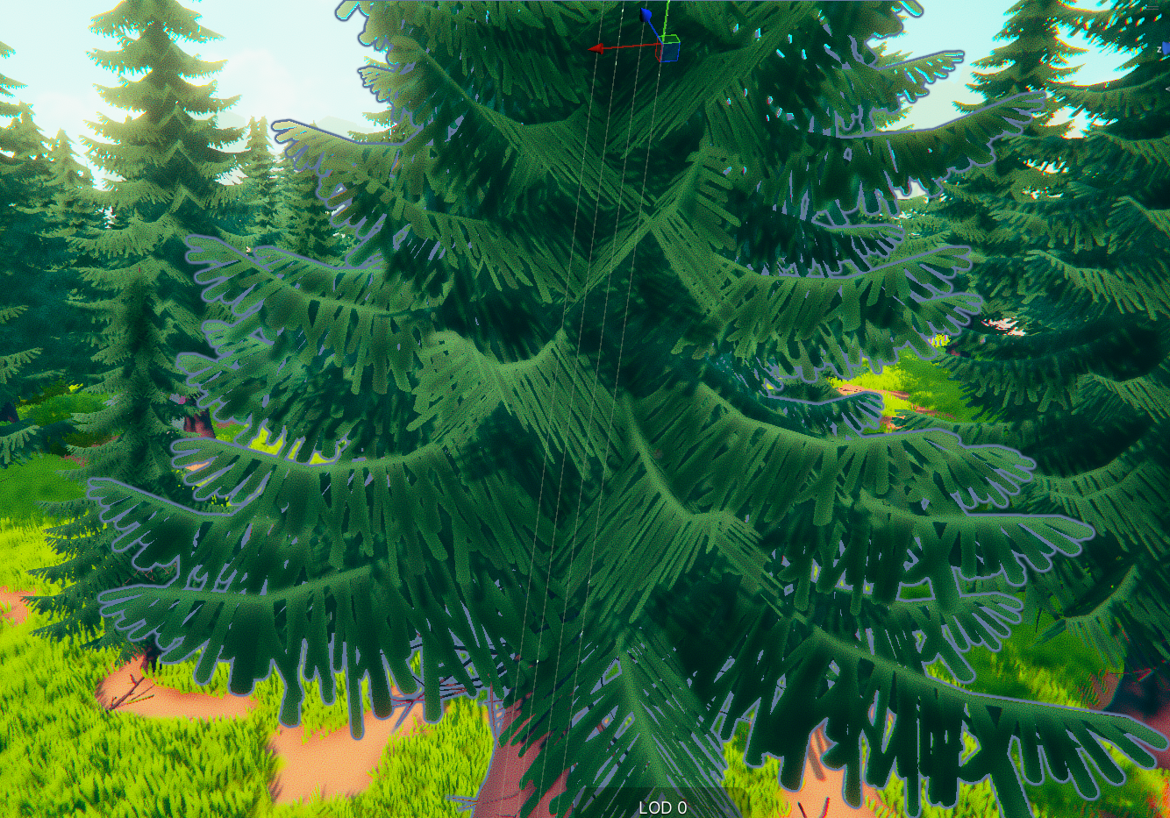

Slide 8
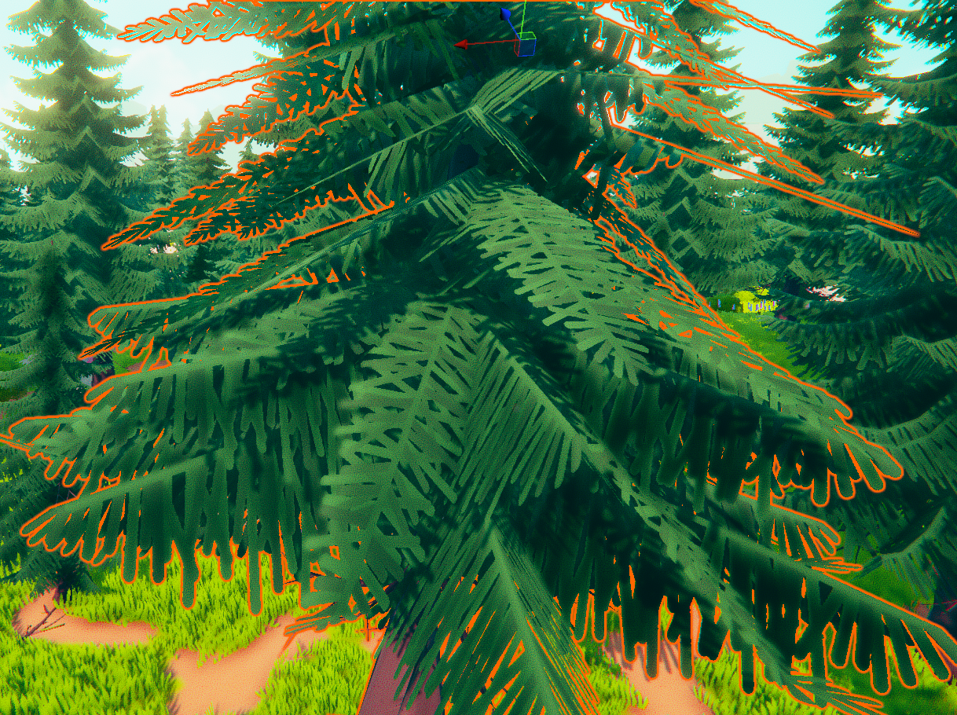

Slide 9
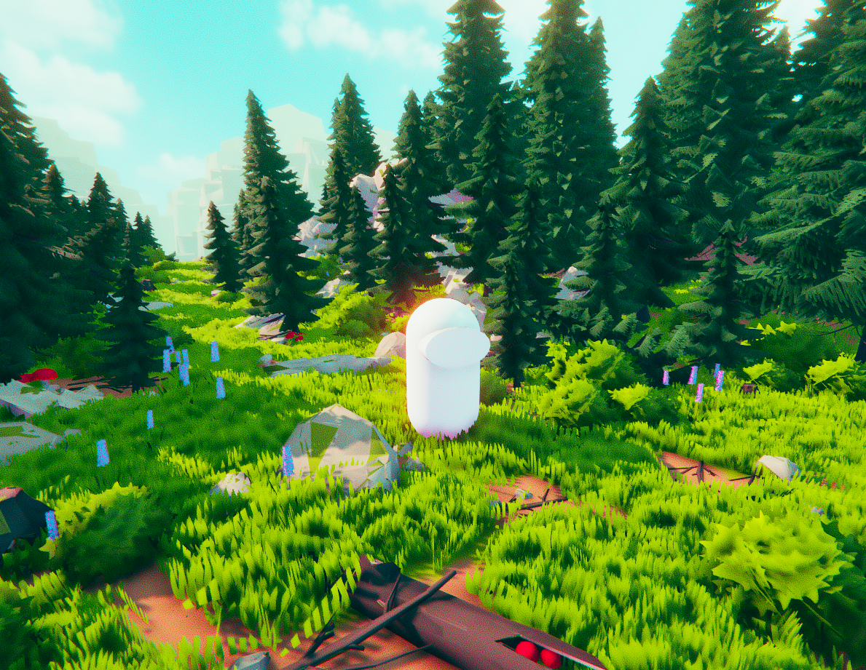
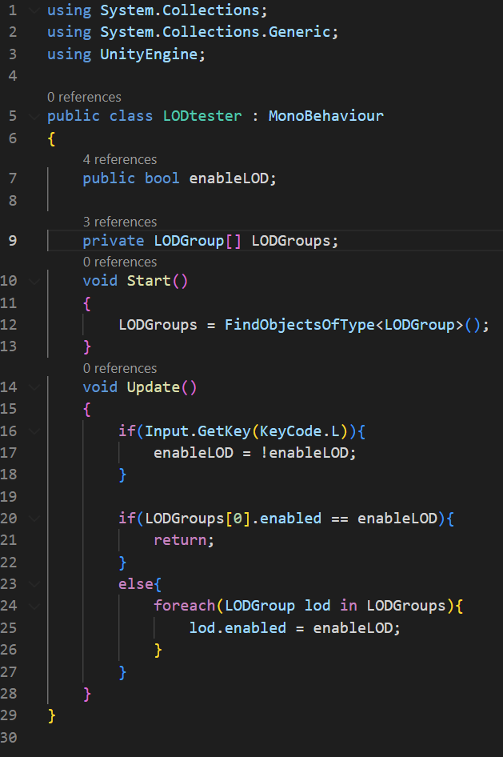
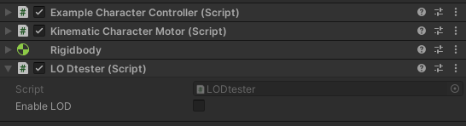

Slide 10
The performance test gameplay video has multiple stages.
Average culling LOD levels disabled
Aggressive culling LOD levels disabled
Minimal culling, LOD levels disabled
Average culling LOD levels enabled
Aggressive culling LOD levels enabled
Minimal culling, LOD levels enabled

Slide 11
